Slide 1
More Conditionals
Truthy and Falsy | Conditional (ternary) operator | Switch statement
Notes:
Welcome to our lecture on some more conditional statements. In this lecture we will go through truthy and falsy values, ternary operators, and switch statements. Let’s start our lecture.

Slide 2

Truthy and Falsy
Truthy Values: Non-Boolean values that evaluate to true in a Boolean context (e.g., if (18) evaluates to true because non-zero numbers are truthy).
Falsy Values: Non-Boolean values that evaluate to false in a Boolean context (e.g., if (null) evaluates to false because null is a falsy value).
Examples of Falsy Values: Common falsy values include null, 0, false, undefined, NaN, and an empty string ("").
Notes:
In JavaScript, truthy and falsy values determine how non-Boolean values behave in Boolean contexts. Truthy values are non-Boolean values that evaluate to true, such as non-zero numbers or non-empty strings. Falsy values evaluate to false, including null, 0, false, undefined, Not a number, and empty strings. Understanding these concepts is essential for writing effective conditional statements.

Slide 3
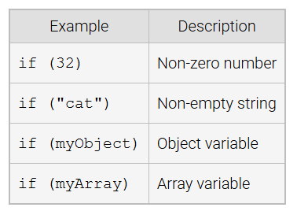
Truthy Values
Notes:
Truthy values in JavaScript are non-Boolean values that evaluate to true in conditional statements. Examples include non-zero numbers like 32, non-empty strings like cat, object variables like my Object, and array variables like my Array. These values are inherently treated as true in Boolean contexts, making them essential for decision-making in programming.

Slide 4
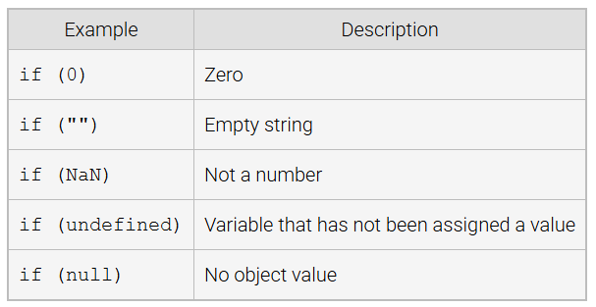
Falsy Values
Notes:
In JavaScript, falsy values are treated as false in Boolean contexts. Examples include 0, representing zero, an empty string like empty double quotation, NAN for not a number, undefined for variables without assigned values, and null for no object value. When used in conditional statements, these values cause the condition to evaluate as false, making them essential to understand for logical operations.

Slide 5
Conditional (ternary) operator
Definition: The conditional (ternary) operator provides a concise way to write conditional statements.
Syntax: It consists of three operands: condition ? expression1 : expression2.
Functionality: If the condition is true, expression1 is returned; otherwise, expression2 is returned.
Notes:
Now we investigate conditional or ternary operator that allows for concise conditional statements. It has three parts: a condition, followed by a question mark, then expression 1, a colon, and expression2. If the condition evaluates to true, expression 1 is returned; otherwise, expression 2 is returned. This operator is ideal for simplifying code by replacing longer if-else statements.

Slide 6
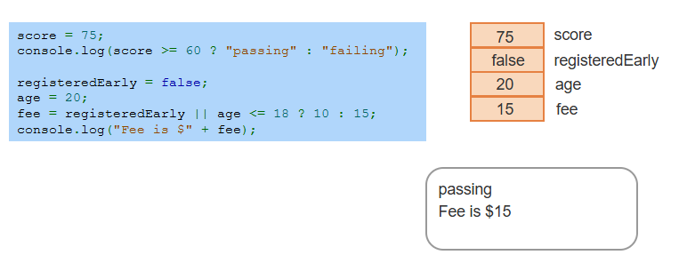
Example
Notes:
This example demonstrates the conditional operator. The first statement checks if the score is 60 or higher, returning passing if true and failing if false. The second uses the operator to determine the fee based on registration status or age. Since registered Early is false and age is 20, the fee is set to 15. The outputs are passing for the score and fee is 15 dollar for the calculated fee.

Slide 7
Switch Statement
Definition: A switch statement provides an alternative to multiple else-if statements by comparing an expression's value to several cases using strict equality (===).
Execution Flow: The first matching case's statements are executed, and if no case matches, an optional default case executes.
Break Statement: The break statement ends the case execution; omitting it causes the execution to continue into the next case, regardless of whether it matches.
Notes:
A switch statement simplifies multiple else-if conditions by comparing an expression to several cases using strict equality. The first matching case runs, and if no match is found, the default case executes if present. The break statement stops execution after a case. Without break, execution continues into the next case, even if it does not match, which is called fall-through behavior.

Slide 8
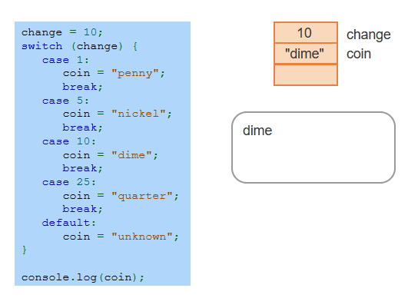
Example
Notes:
This example demonstrates a switch statement. The variable change is set to 10, and the switch compares it to defined cases. In case 10, the coin is set to dime, and the break stops further execution. If no match was found, the default case would set coin to unknown. The output of console.log is dime, as the case for 10 matches the value of change. The switch provides a clear alternative to multiple if-else statements. Thanks for watching the lecture.

